Slide 1


K.RAMAKRISHNAN COLLEGE OF TECHNOLOGY
(AUTONOMOUS), TRICHY
A Robust Representation Learning Approach for Privacy-Preserving Machine Learning Using a Multi-Objective Autoencoder”
PRESENTED BY GUIDED BY
KAVILAKSHMI B -2403811724322045 Mr.A.JOSHUA ISSAC.M.E.,(PhD).,
KAVIN ADHITHYA A S -2403811724321046 AP /AIDS
KAVITHA P - 2403811724322047
KAVIYA K - 2403811724322048

Slide 2
PRESENTATION OVERVIEW
Abstract
Objective
Architecture diagram
Literature survey
Research methodology
Existing system
Proposed system
Conclusion
Future enhancement

Slide 3
ABSTRACT
Protects sensitive data during machine learning.
Uses a Multi-Objective Autoencoder for feature learning.
Balances privacy, data utility, and model accuracy.
Prevents leakage of confidential information.
Suitable for healthcare, finance, and smart applications.

Slide 4
OBJECTIVE
Preserve user privacy in machine learning.
Learn robust and meaningful data representations.
Reduce sensitive information leakage.
Maintain high prediction accuracy.
Improve secure AI applications.

Slide 5
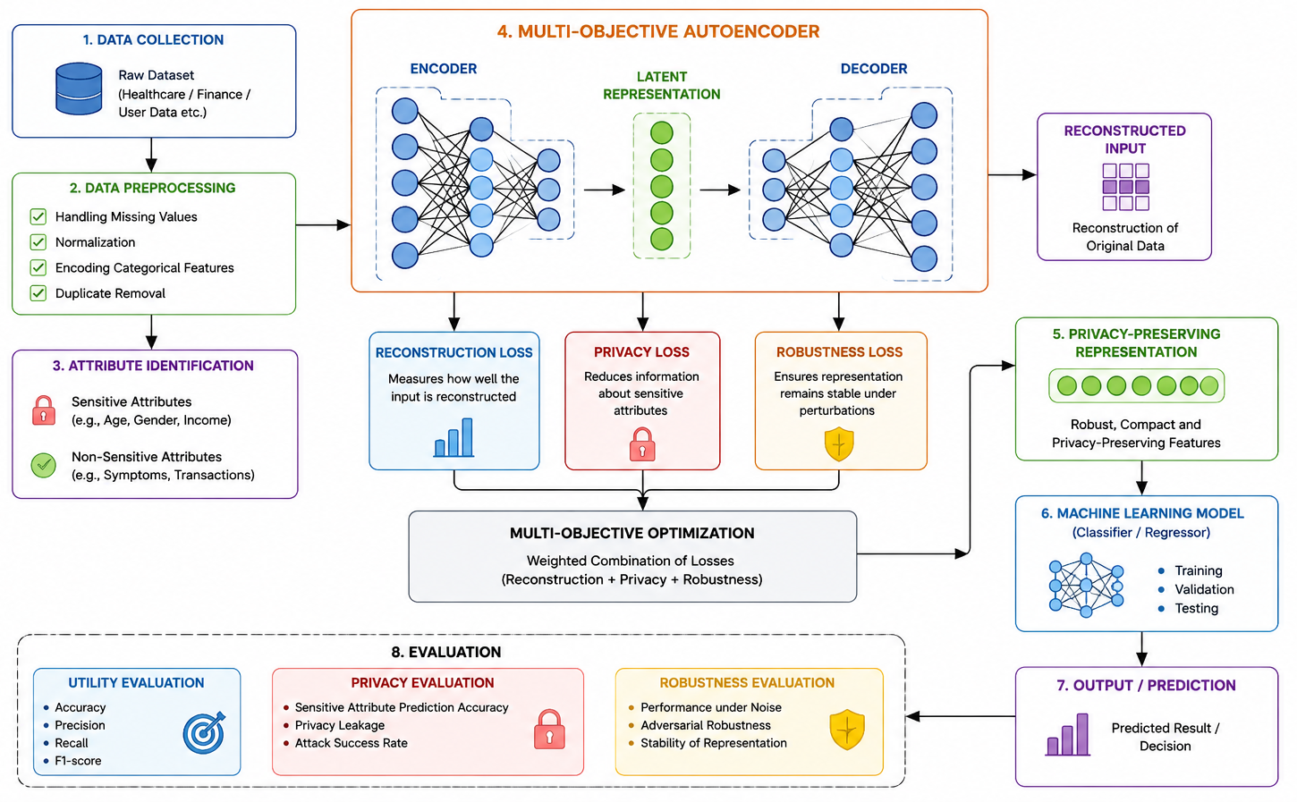
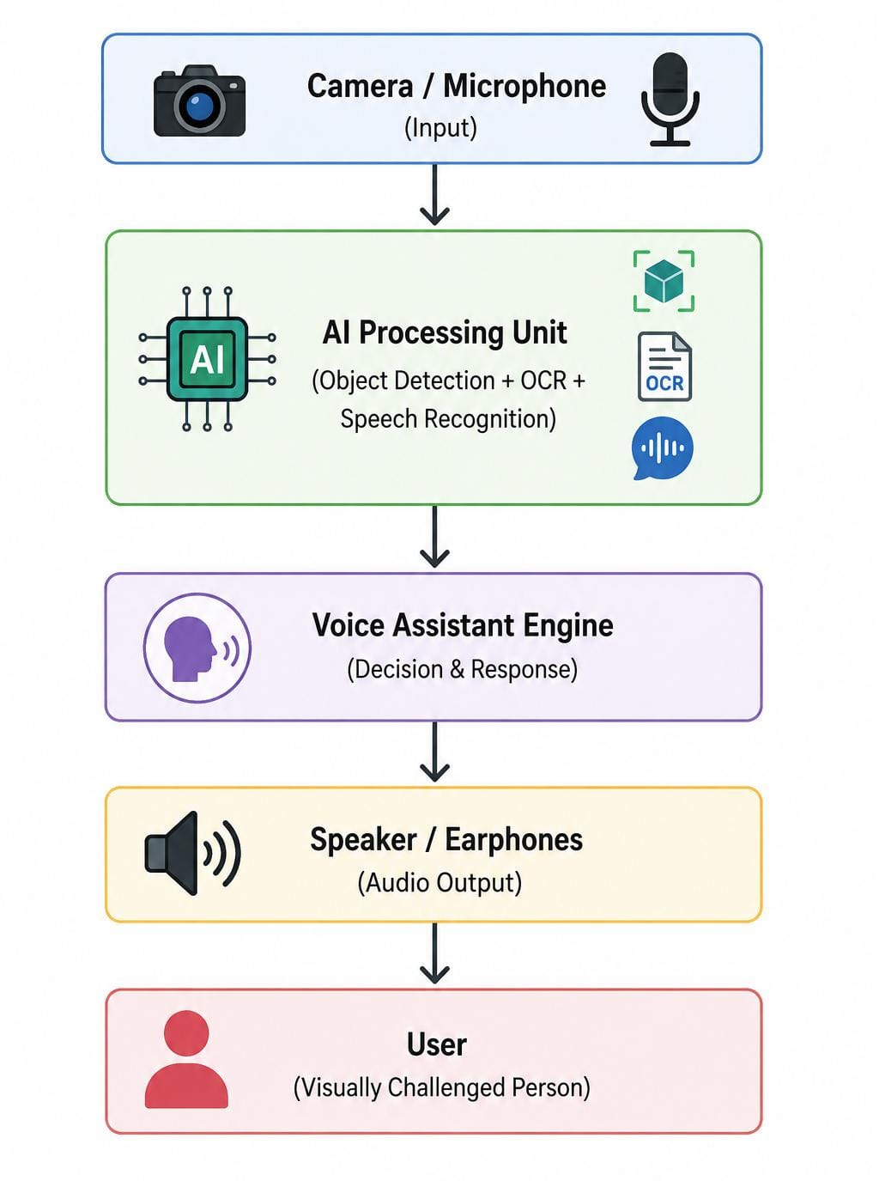
ARCHITECTURE DIAGRAM

Slide 6
LITERATURE SURVEY
Literature_Survey_Robust_Privacy_Preserving_ML_Final 2 gpt.xlsx

Slide 7
RESEARCH METHODOLOGY
Collect and preprocess the dataset by handling missing values and normalizing features.
Identify sensitive and non-sensitive attributes in the dataset.
Train a Multi-Objective Autoencoder to learn a robust latent representation.
Optimize reconstruction, privacy, and robustness objectives simultaneously.
Use the learned privacy-preserving representation for machine-learning prediction.
Evaluate the model based on accuracy, privacy protection, and robustness.

Slide 8
EXISTING SYSTEM
Traditional machine learning models.
Limited privacy protection.
Sensitive data can be leaked.
High risk of attacks.
Lower robustness against adversarial threats.

Slide 9
PROPOSED SYSTEM
Multi-Objective Autoencoder framework.
Learns privacy-preserving representations.
Optimizes reconstruction and privacy simultaneously.
Produces robust features for classification.
High accuracy with improved data security.

Slide 10
CONCLUSION
Enhances privacy in machine learning.
Protects confidential user information.
Maintains strong prediction performance.
Generates robust feature representations.
Suitable for real-world secure AI systems.
Notes:
10

Slide 11
FUTURE ENHANCEMENT
Federated learning integration.
Differential privacy techniques.
Blockchain-based secure data sharing.
Real-time deployment on edge devices.
Support for multimodal datasets.

Slide 12
THANK YOU

